Slide 1
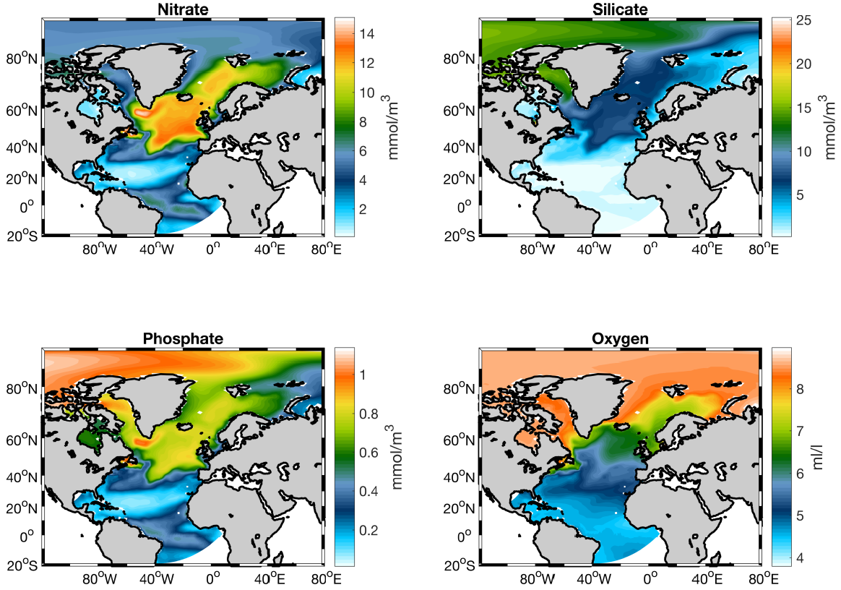


Biological Reanalysis with Online Parameter Estimation in the North Atlantic and the Arctic
M. E. Gharamti*, L. Bertino⁺, A. Samuelsen⁺, A. Korosov⁺
*National Center for Atmospheric Research
Boulder – CO, USA
⁺Nansen Environmental and Remote Sensing Bergen, NORWAY
gharamti@ucar.edu

Slide 2
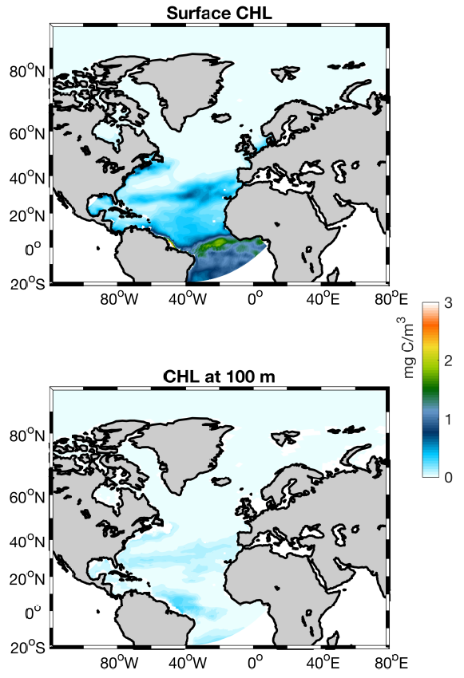
Table of Contents
Research Problem
The Data Assimilation System
The coupled physical-biogeochemical model
State-parameter estimation scheme
Preliminary Results (WIP)
Conclusion

Slide 3
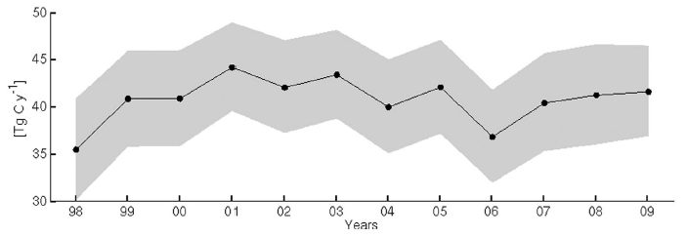
Biological Reanalysis
Why it is useful ?
Nerger & Gregg (2007):
1998-2004 using CHL SeaWiFS
DA into NASA’s OBM investigating PP
Gregg (2008):
Spatial CHL patterns
Fontana et al. (2013):
1998-2006 using CHL SeaWiFS
Spatial and temporal patterns of CHL and NIT
Gregg & Rousseaux (2014, 2015):
1998-2012 using CHL SeaWiFS
Significant trends different oceanic regions
Ciavatta et al. (2015):
1998-2009 using ESA’s OC-CCI ocean color
Understanding North West European shelf-sea
Quantify seasonal and interanual variability
Better understanding of the physics-biology coupling
Climate projections
Environemental monitoring & Marine policy
Fisheries
Carbon cycle
Carbon uptake by the shelf

Slide 4
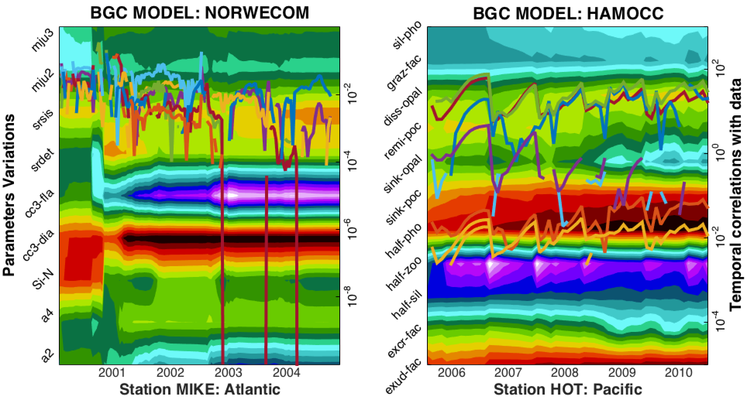
Biogeochemical Model Parameters
Biogeochemical models, despite their continuous improvements, are still highly parameterized
Quality of the prediction strongly correlates with such parameters (mortality, grazing, growth)
Parameters:
Spatially constant?
How about temporally?
Dependencies!
Missing and complex dynamics
Gharamti et al. (2016): Online tuning of ocean biogeochemical model parameters using ensemble estimation techniques: Application to a one-dimensional model in the North Atlantic. JMS, 168, 1-16.
Gharamti et al. (2017): Ensemble data assimilation for ocean biogeochemical state and parameter estimation at different sites. OM, just accepted.
4

Slide 5
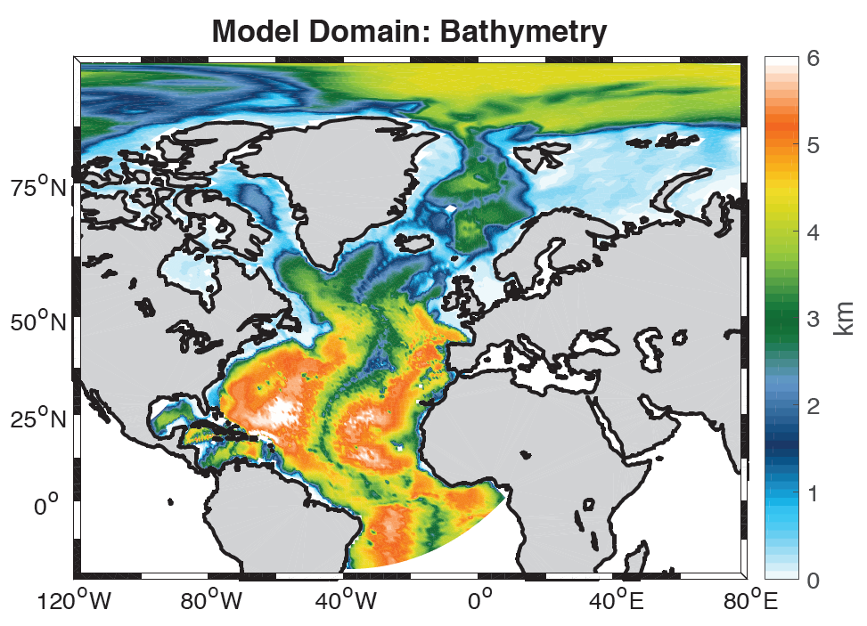
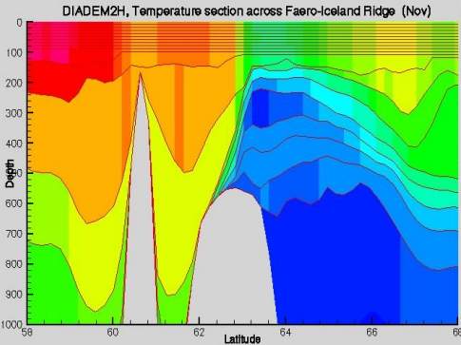
The Coupled Model: I. Physics
HYCOM: 3D numerical ocean model
Hybrid coordinates:
Isopycnal interior
Z-coordinate at Surface
Grid: 216x144 (50km spacing)
23 layers
One-thickness-category sea-ice model with EVP rheology [Hunke & Dukowicz, 1999]
Forcing: ERA-interim atm. fluxes (6hr)
Rivers: Climatology
More details in [Sakov et al., 2012]
5
5

Slide 6
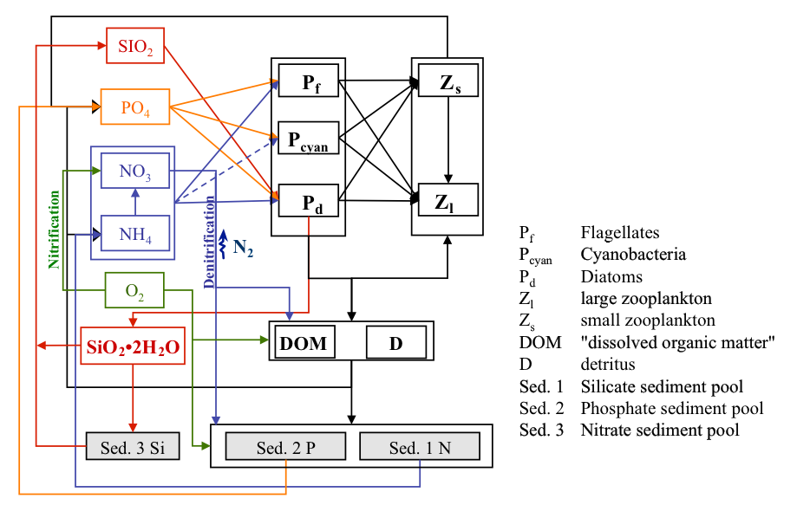
The Coupled Model: II. Biogeochemistry
ECOSMO I: [Schrum et al., 2006]
ECOSMO II: [Daewel & Schrum, 2013]
NPZD-type
Processes
Remineralization
Nitrification
Denitrification
Sinking
Deep sedimentation
+ Carbon cycle
14 variables
4 nutrients
3 phyto-clases
2 zoo-classes
First large-scale DA application using ECOSMO!
6
6
6

Slide 7
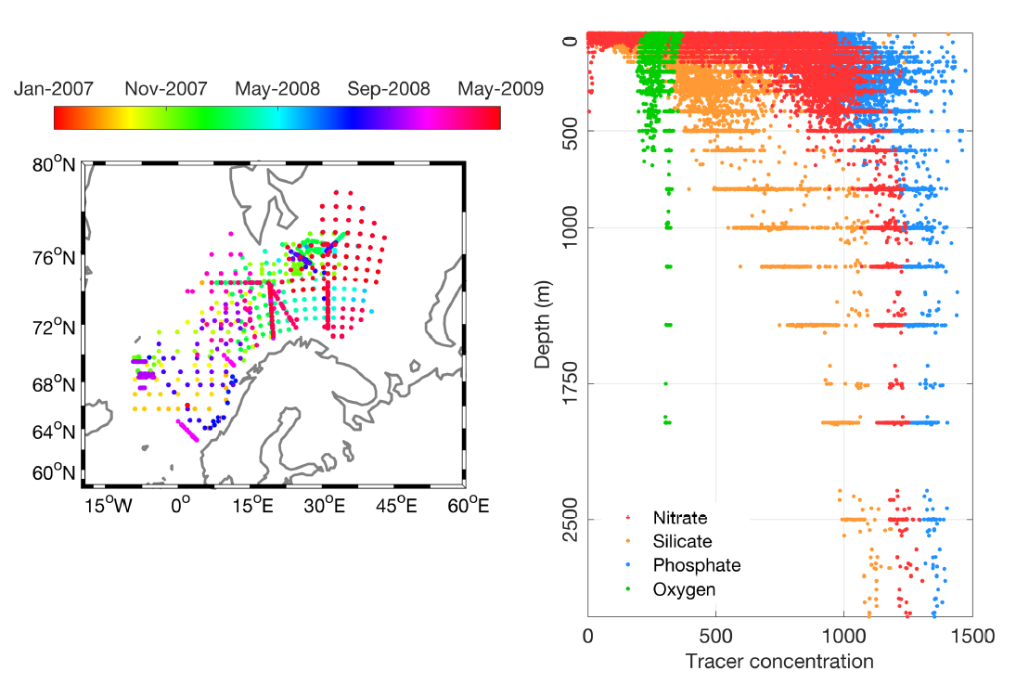
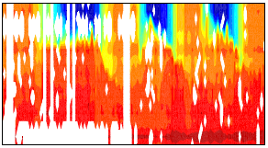
The Data: I. in-situ Nutrients & Oxygen
NO3, PO4, SiO2, O2 profiles between Jan 2007 and Jul 2009
Both dense in space and time (2-3 days)
Data as Deep as 3 km in the water column
Cruise ships off the Norwegian shelf in the Atlantic and the North Sea
[Institute for Marine Research, IMR]
NO3 from MIKE Weather Station
7
7
7
7

Slide 8
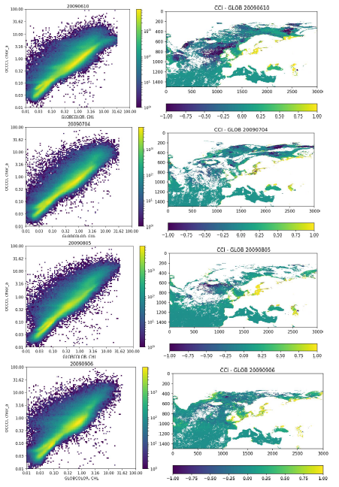
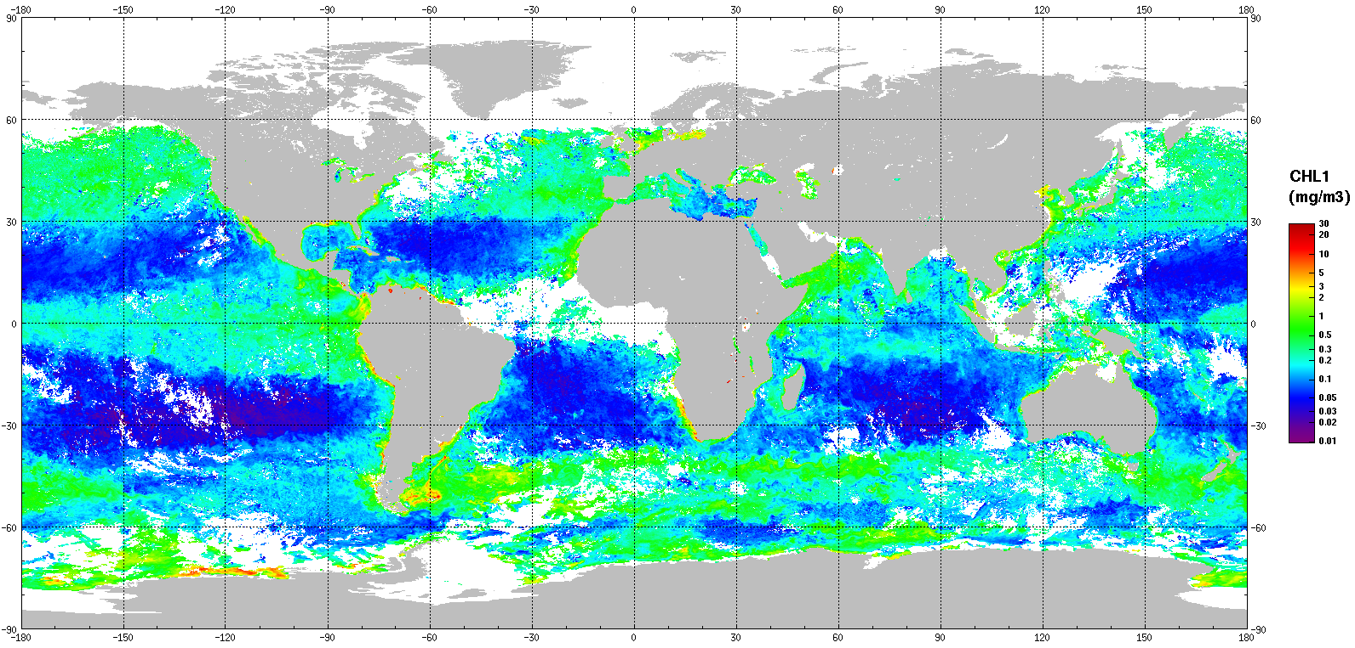
The Data: II. Satellite CHL
Climate Consistency …
Ocean color using GlobColour product
Jan 2007 – Dec 2014
8 days temporal resolution
8
8
8
8
8

Slide 9
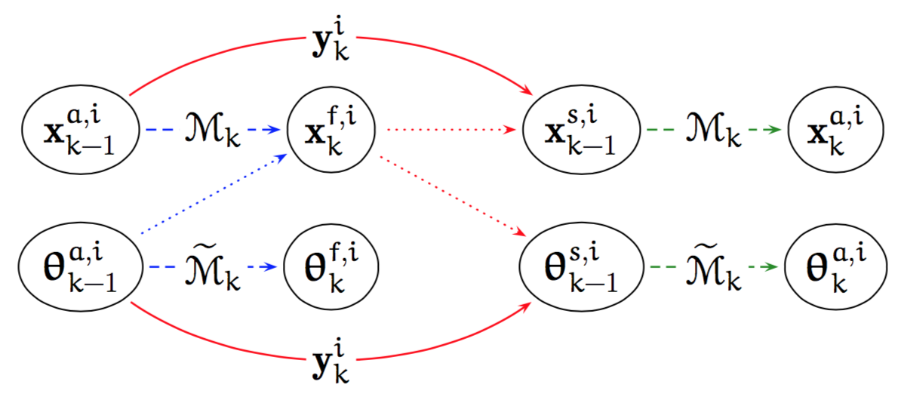
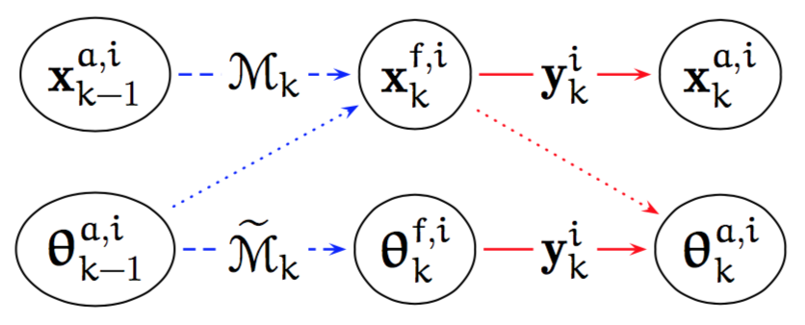
The Data Assimilation System
One-Step-Ahead (OSA) smoothing State-Parameter Estimation
Joint State-Parameter Estimation
[Gharamti et al., 2015]
OSA-EnKF with 80 members
Assimilation period 2007-2014
No physical data assimilation nor estimation of physical variables
States variables include
14 biogeochemical tracers
8 biogeochemical parameters
ECOSMO PARAMETERS
Flagellate Growth
Diatoms Growth
Flagellate mortality
Diatoms mortality
Micro-Zooplank mortality
Meso-Zooplank mortality
Sinking of Det and Opal
C -- Si ratio
9
9
9
9
9
9

Slide 10
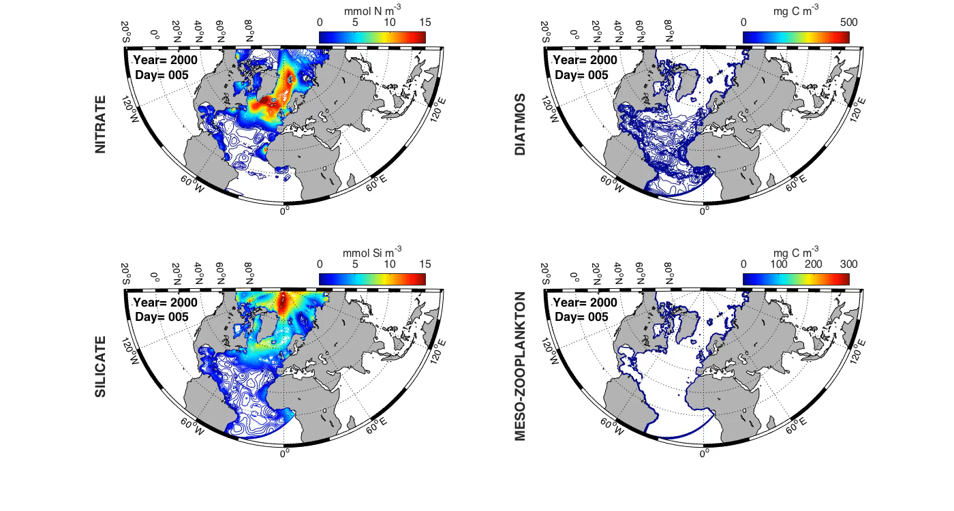
Initialization & Spin-Up
Model Spin-up
Physical model initialized in 1973 and integrated to 2000
Random perturbation to atmospgheric forcing; spectral method w/ correlation radius of 250 km [Evensen, 2003]
Climatology for Nutrients
Nominal parameters perturbed with truncated Gaussian errors with 30% standard deviation
7 years spinup from 2000-2006
10
10
10
10
10
10

Slide 11
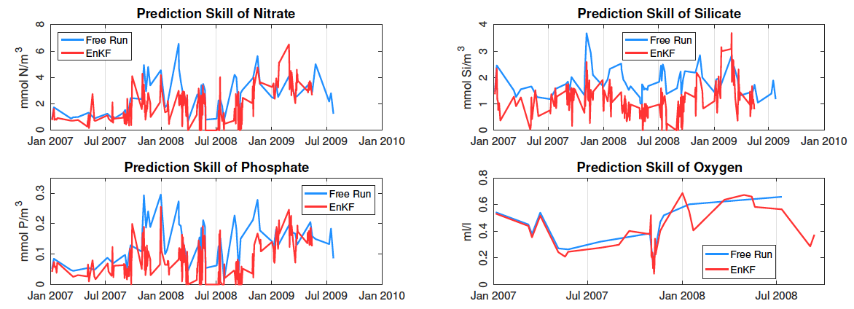
Results: Nutrients
 | NO3 | SiO2 | PO4 | O2
OSA-EnKF w/ PE | 22.30% | 53.47% | 38.77% | 23.37%
EnKF w/o PE | 9.13% | 21.45% | 17.54% | 19.89%
Average gain over the Free-Run estimates:
11
11
11
11
11
11
11

Slide 12
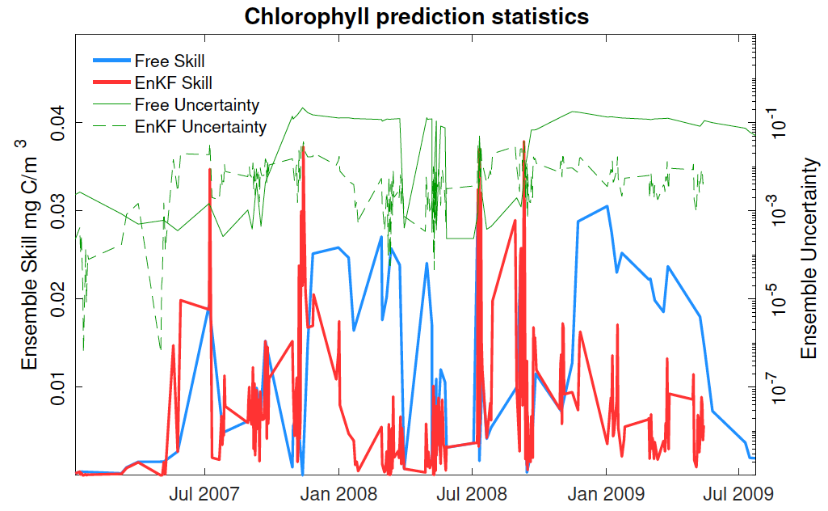
Results: Chlorophyll
Increase in ensemble uncertainty during the bloom periods
~40% improvement in skill
Consistency between the RMS and the spread ~10⁻²
12
12
12
12
12
12
12
12

Slide 13
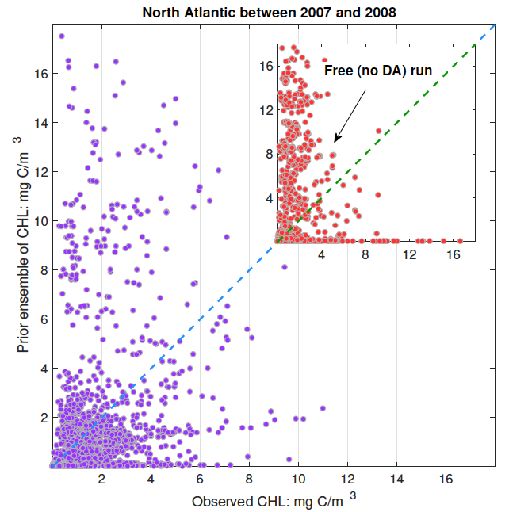
Results: Chlorophyll cont.
ECOSMO tends to strongly overestimate chlorophyll in the northern Atlantic region
OSA-EnKF increases the correlation with the satellite observation by almost 5 times
The improvements are only marginal with no PE
13
13
13
13
13
13
13
13
13

Slide 14
Results: Parameters
Large initial uncertainty diminishes mostly during the spring bloom (strong constraining by the data)
[1] Phytoplankton Growth:
Smaller uncertainty in DIATOMS
Observe the change in pdfs
Convergence around 1.55 day⁻¹
Larger uncertainty in FLAGELLATES
~50% increase to initial values
Big changes during 1st bloom
[2] Phytoplankton Mortality:
DIATOMS rate after 4 yrs is almost the same as the initial value
FLAGELLATES rate strongly decrease during 2008
Adjust CHL in the model
14
14
14
14
14
14
14
14
14
14

Slide 15
Results: Parameters cont.
Systematic decrease in Zooplankton (Micro & Meso) mortality rates.
No clear convergence!
Possible reasons:
Increase the grazer biomass, so more grazing can take place on phyto groups. Such grazing allows for a better fit of the over-estimated CHL in the model
Increased grazing can help decrease the uptake of silicate and thus adjust the silica cycle (Free-Run RMS of SiO2 is high due to strong underestimation)

Slide 16
Results: Parameters cont.
Sinking rate of detritus and opal decreases, to slow the remineralization process and allow the model to adjust the Surface nutrients
C/Si uncertainty decreases and then increases only marginally
No clear convergence for C/Si
Distribute in spatial regions; more silicate in the Arctic than other regions
16
16
16
16
16
16
16
16
16
16
16

Slide 17
Results: Parameters cont.
Positive correlation between meso-zooplankton mortality and sinking rate of DET & OPAL (makes sense!)
Strong negative correlation between Flagellate growth rate and meso-zooplankton mortality
Insights into the model’s parameterization. Reduce the number of parameters?
17
17
17
17
17
17
17
17
17
17
17
17

Slide 18
Conclusion
Presented initial effort to perform a biological reanalysis in the North Atlantic & Arctic
Current system shows encouraging prediction skill
A number of issues with the parameters estimates after 2010
More thoughts on spatially discretizing the parameters, reducing the number of dependent/correlated parameters
Parameter estimation seems an essential part of the reanalysis (maybe not as important for physical reanalysis)
How CHL model bias changes when using ESA’s product?
Localizing scalar variables?!
18

